Slide 1
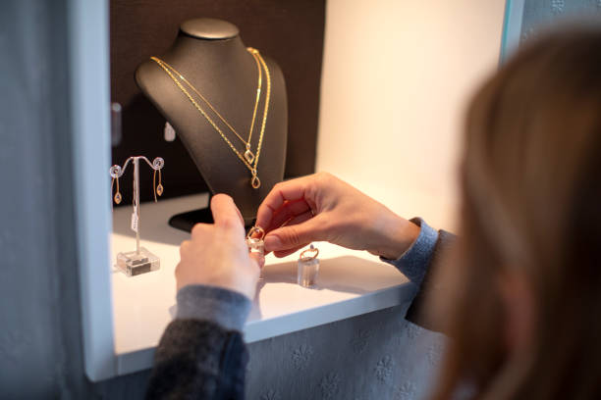
Name: Rama Krishna Kamma
CWID: 50321021
Professor: Dr. Srujan Kotikela
Project: Worldwide analysis of crimes by the traces of their online media coverage: The case of jewellery store robberies.

Slide 2
Contents
Abstract
Introduction
Why Online Crime Investigation
Role of Online Media in Crime Reporting
Methodology
Example
Advantages
Limitations
Future Direction
Conclusion

Slide 3
Abstract
This empirical study tries to examine whether information about individual crimes around the world may be obtained from online media coverage.
A measure of the global dissemination of jewelry store robberies is the standard of web news. This phenomenon was chosen because it is difficult for private enterprises to assess the risk of criminal occurrences on a worldwide scale.
Using a dataset of articles from the news aggregator website which named EMM (Europa Media Monitor - News Brief) that was collected between 2015 and 2017. The findings indicate that online news may be an affordable way to assess hazards globally, however, to ensure its accuracy, a cross-check with other data sources is still necessary.
While a multilingual approach is required, the developed method shows that cases may be located and automatically categorized with high accuracy. Furthermore, there is no need for complex text analysis methods because the publication dates and nations of news stories are often accurate indicators of the actual times and places of the occurrences.
This study demonstrates the effectiveness of simple monitoring can help the global spatiotemporal analysis of significant crimes like robbery of jewelry stores.

Slide 4

Introduction
The worldwide analysis of jewellery store robberies is a crucial endeavor for understanding crime patterns and developing effective preventive measures.
By leveraging the traces of online media coverage, researchers can gain valuable insights into the occurrence, characteristics, and dynamics of these crimes.
Online media platforms have become primary sources of real-time news and information dissemination, making them a rich dataset for analysis.
This presentation explores the methodology and findings of the worldwide analysis, highlighting the significance of online media in understanding and combating jewellery store robberies.

Slide 5
Why Online Crime Investigation?
Real-time information: Online media provides immediate and up-to-date coverage of criminal incidents. This real-time data can help in identifying emerging crime trends and patterns.
Geographical analysis: By analyzing news articles, social media posts, and other online sources, researchers can identify hotspots, crime-prone areas, and regional variations in criminal activities.
Public perception and fear of crime: Studying online media coverage helps in understanding how crime narratives are constructed, how they influence public opinion, and how they shape policy decisions.
Insights into criminal networks and trends: Online media coverage can provide valuable information about criminal networks, their connections, and their activities.
Evaluation of law enforcement effectiveness: Analyzing how crimes are reported, investigated, and resolved provides insights into the strengths and weaknesses of law enforcement strategies.

Slide 6
Role of Online Media in Crime Reporting
Online media platforms have transformed into primary sources for news and information dissemination due to several key factors:
Wide Accessibility: With the proliferation of smartphones, tablets, and computers, people can access news content anytime, anywhere, as long as they have an internet connection.
Multimedia Content: Online media platforms offer a wide range of multimedia content, including text articles, images, videos, and interactive elements. It allows for the integration of visual storytelling, interviews, and live streaming, providing a more comprehensive understanding of news events.
User-Generated Content: Online media platforms enable user-generated content through social media platforms, blogs, and comment sections. Users can actively participate in news discussions, share personal experiences.
Global Reach and Virality: Online media platforms facilitate the rapid dissemination of news on a global scale. News articles, videos, or posts can be shared, retweeted, or re-shared by users, leading to exponential reach and potential virality.

Slide 7
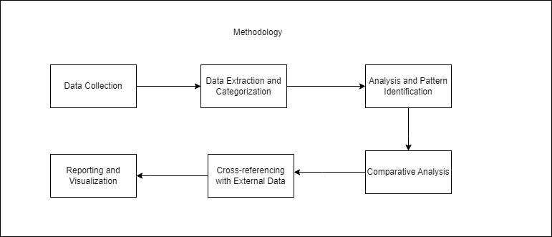
Methodology

Slide 8
Methodology..
Data Collection: The first step is to collect relevant data related to jewellery store robberies. This data can be obtained from various online sources, including news articles, online news portals, police reports, social media platforms, and specialized crime databases(using web scraping).
Data Extraction and Categorization: Once the data is collected, it needs to be extracted and organized for analysis. This involves extracting key information from the sources, such as incident details (date, time, location), description of the robbery(text mining & natural language processing).
Analysis and Pattern Identification: It involves examining factors such as geographical distribution of incidents, temporal patterns, involvement of organized crime networks, and any other significant findings that emerge from the data(entity recognition algorithms).
Comparative Analysis: Comparative analysis is conducted to identify similarities and differences in jewellery store robberies across different regions, countries or time periods(text similarity/hashing).
Cross-referencing with External Data: The collected data on jewellery store robberies can be cross-referenced with external data sources for additional insights. Cross-referencing allows for a broader contextual understanding of the robberies and their implications.
Reporting and Visualization: The findings of the analysis are then compiled into a comprehensive report, which includes an overview of the methodology, data sources, analysis techniques, and key findings.

Slide 9
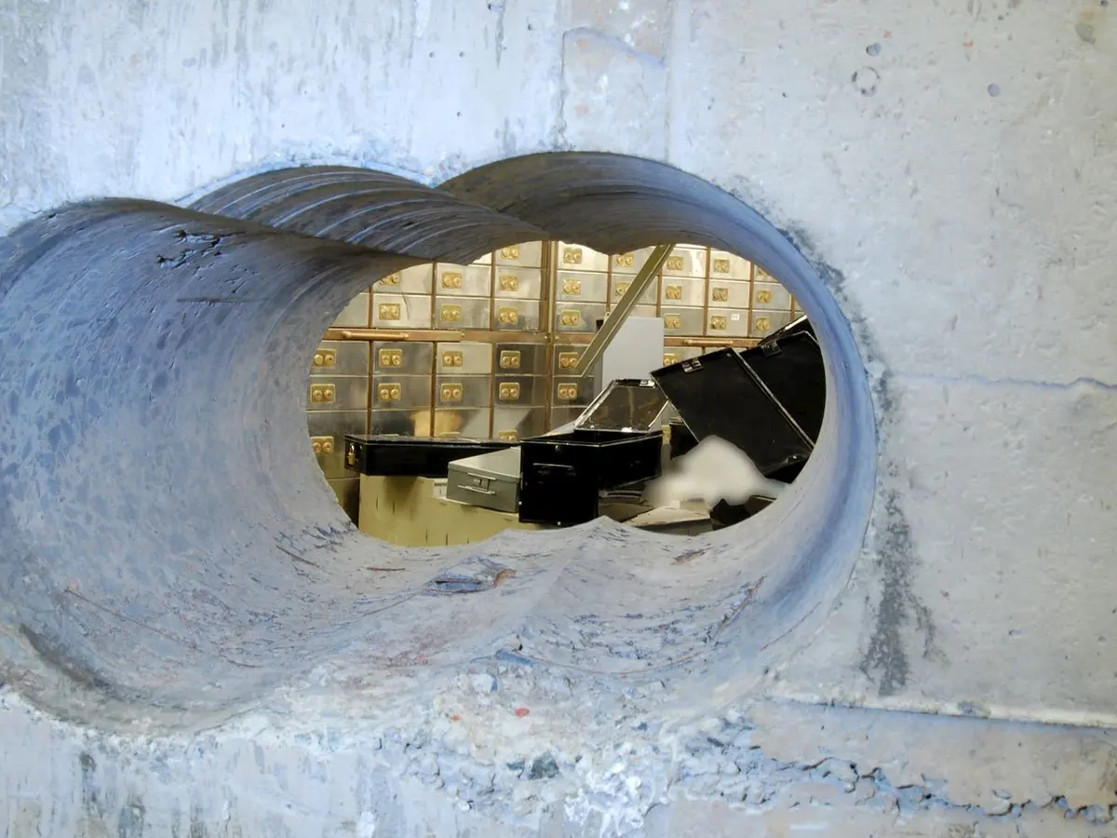
Example: Hatton Garden Jewellery Store Robbery
Location: Diamond Gems Jewellers, London, United Kingdom(April 2015)
Seasoned criminals executed a meticulously planned jewellery store robbery in Hatton Garden, London. They gained entry to the Hatton Garden Safe Deposit Company during the Easter weekend when surrounding offices were closed.
Over several days, they systematically looted cash, jewellery, and valuable items from safety deposit boxes, using wheelie bins and bags to transport their loot.
Media coverage quickly spread, highlighting the scale and complexity of the robbery. The extensive media coverage led to public awareness and pressure on law enforcement to solve the case.
The incident prompted enhanced security measures in the jewellery industry and raised awareness of organized crime involvement.
It emphasized the need for collaborative efforts between law enforcement, forensic experts, and the media to investigate and prosecute such complex crimes.

Slide 10
Advantages:
Real-time and Extensive Coverage: Online media provides immediate and widespread coverage of news events, including jewellery store robberies.
Large and Diverse Data Pool: Online media platforms offer a vast amount of data from various sources including news reports, social media updates, and forums. This diverse dataset allows for a comprehensive analysis and multiple perspectives on jewellery store robberies.
Global Reach and Comparative Analysis: Online media coverage spans across countries and regions, providing a global perspective on jewellery store robberies.
Public Awareness and Information Sharing: Online media coverage generates public awareness about jewellery store robberies, encouraging individuals to report suspicious activities or provide relevant information to law enforcement.

Slide 11
Limitations:
Accuracy and Reliability: Online media sources may vary in terms of accuracy, reliability, and credibility. False or misleading information can be circulated, potentially leading to inaccurate analysis or conclusions.
Language and Cultural Bias: Online media coverage is often influenced by language and cultural biases. Some incidents or regions may receive more attention than others.
Lack of Complete Information: Online media coverage may not provide a complete picture of jewellery store robberies. Some details may be omitted, and the full extent of the incidents may not be accurately reported.
Limited Access to Paywalled Content: Some online news sources may require subscriptions or have paywalls, limiting access to certain articles or information. This can restrict the availability of comprehensive data for analysis.
Privacy and Ethical Concerns: The analysis of online media coverage raises privacy and ethical considerations. The use of personal information and the potential for unintended consequences should be carefully addressed.

Slide 12
Future Direction:
To improve the research work on the worldwide analysis of jewellery store robberies through online media coverage, consider the following strategies:
Refine Search Criteria
Utilize Multiple Online Sources
Validate Data Quality
Include Multilingual Analysis
Collaborate with Law Enforcement Agencies
Apply Advanced Data Analysis Techniques
Conduct Case Studies
Incorporate Victim Perspectives
Include Comparative Analysis
Seek Feedback and Peer Review

Slide 13
Conclusion:
This study demonstrates how criminal intelligence on a certain phenomena can be gathered through web news.
Its application to jewelry store robberies suggests that it would be possible to keep track of the dangers associated with such crimes on a global scale.
This study concentrated on creating a specialized process that would result in a functional prototype in order to accomplish this goal.
The findings demonstrate the value of open sources for quickly, easily, and affordably identifying jewelry store crimes around the world.

Slide 14
Thank you

Slide 15
YouTube URL:
https://youtu.be/C_pXqyIWQY0

